Slide 1

CSE 298 – Foundations of Robotics
Lecture 2 - Sensors

Slide 2



Slide 3
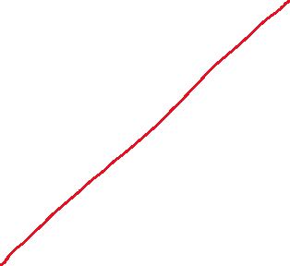




Slide 4



Slide 5


Slide 6


Slide 7



Slide 8


Slide 9
